Slide 1
The Mayo Clinic Expanded Access Protocol: Expanded Access to Convalescent Plasma for the Treatment of Patients with COVID-19
Dial in (Main): (415) 930-5321
Dial in (Alt): (646) 307-1722
Access Code: 771-626-792
Slides in “Handout” Tab
Molly Klote, MD C. Karen Jeans, PhD
Director, ORPP&E Director, Regulatory Affairs
ORPP&E
April 15, 2020

Slide 2
Discussion Topics
Purpose of using convalescent plasma as a possible treatment for COVID-19
Process for initiating the Mayo Clinic Convalescent Plasma Expanded Access Program
  Institutional responsibilities
  Patient inclusion criteria
  Informed consent requirements
Plasma Donation

Slide 3
FDA Regulated Research Studies: Common Pathways for Use of Drugs and Biologics
U.S. Drugs and Biologics
Approved Drugs and Biologics
Investigational Drugs and Biologics
(Non-Approved)
Use According to FDA Marketed Label
Off Label Use of Approved Drug
Commercial and
Non-Commercial Investigational New Drug Applications
Expanded Access
Right to Try

Slide 4
Research Committees or Subcommittees Involved in the Review or Approval of VA Physician Requests for Investigational Drug or Biologics Through Expanded Access
Emergency IND
(Example: Remdesivir)
No Prospective IRB Approval
IRB Notification Required 5 Working Days After Beginning Administration
No VA Research and Development Committee approval
Non-Emergency Expanded Access
Prospective IRB Approval Required
Prospective VA Research and Development Committee approval Required
*Designated Review can be used when a single patient use is approved by the IRB Chair or another appropriate IRB voting member as permitted by FDA.

Slide 5
Research Committees or Subcommittees Involved in the Review or Approval of VA Physician Requests for Investigational Drug or Biologics Through Expanded Access
Emergency IND
(Example: Remdesivir)
No Prospective IRB Approval
IRB Notification Required 5 Working Days After Beginning Administration
No VA Research and Development Committee approval
Non-Emergency Expanded Access
Prospective IRB Approval Required
Prospective VA Research and Development Committee approval Required
*Designated Review can be used when a single patient use is approved by the IRB Chair or another appropriate IRB voting member as permitted by FDA.

Slide 6
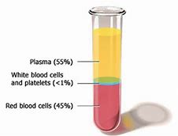
Plasma
Plasma is the liquid in your blood that does not contain cells
  It contains antibodies
It still has to be cross-matched to your blood type before infusion

Slide 7

Plasma Cell
Corona

Slide 8
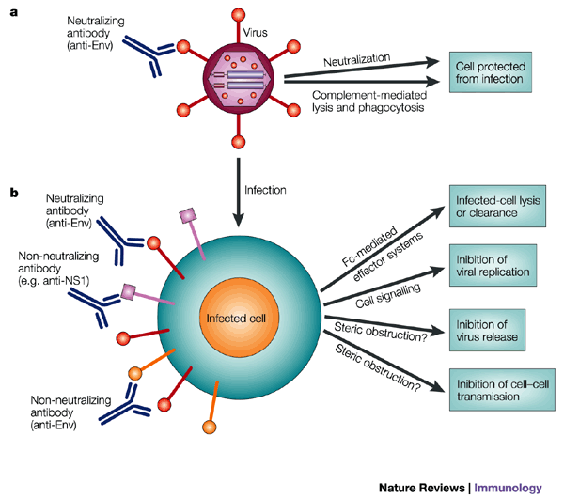
Antibody Effects on Viruses
Antibodies can directly attack the virus
Antibodies can attack a cell that the virus has entered

Slide 9
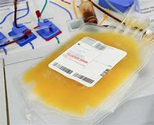
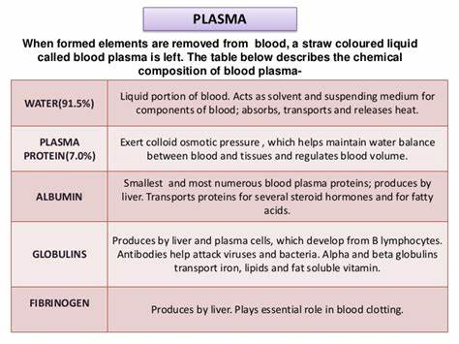
Bag of Plasma
Antibodies

Slide 10
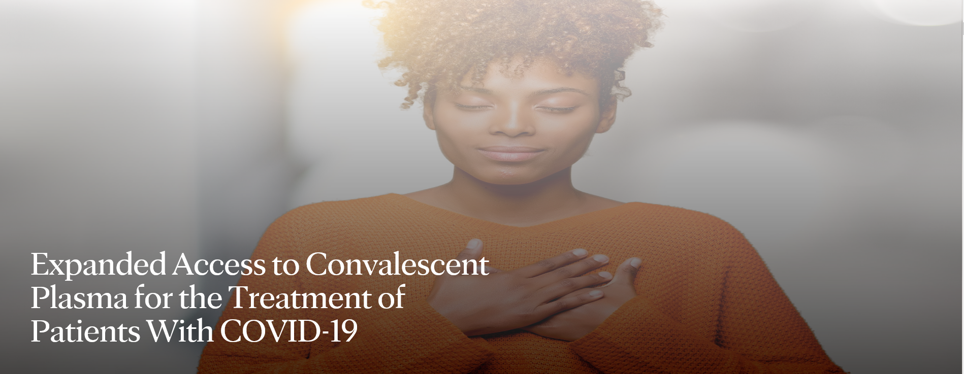
Expanded Access Program: Expanded Access to Convalescent Plasma for the Treatment of
COVID-19
https://www.uscovidplasma.org

Slide 11
Possible Benefits
Patients with COVID-19 may improve faster if they receive plasma from those who have recovered from COVID-19, because it may have the ability to fight the virus that causes COVID-19.
Initial data available from studies using COVID-19 convalescent plasma for the treatment of individuals with severe or life-threatening disease indicate that a single dose of 200 mL showed benefit for some patients, leading to improvement.
COVID-19 convalescent plasma has not yet been demonstrated to provide clinical benefit in patients affected by this disease.
It's not known if this treatment will or will not help those with COVID-19 or if it will have any harmful effects, but this is one of the only treatments that we have at present.

Slide 12
Status of Program: Expanded Access to Convalescent Plasma for the Treatment of
COVID-19
Program participation as of April 14, 2020:
  Sites registered: 1046
  Physicians: 952
  Patients enrolled: 436
  Number of patients who have completed transfusion: 118

Slide 13

Mayo Clinic IRB of Record
Selected as IRB of Record by the FDA for this Expanded Access Treatment IND
VA ORD and ORO coordinated to develop supplemental documents so VHA Facilities could participate

Slide 14
IRB Reliance Agreement
The CRADO signed an agreement between VHA and Mayo Clinic IRB
  Outlines responsibilities of institutions and the IRB with regard to this protocol
Your Medical Center Director must sign the form,” Concurrence with the Office of Research and Development (ORD) Agreement with Mayo Clinic Institutional Review Board (IRB) For Mayo Clinic IRB Oversight”

Slide 15
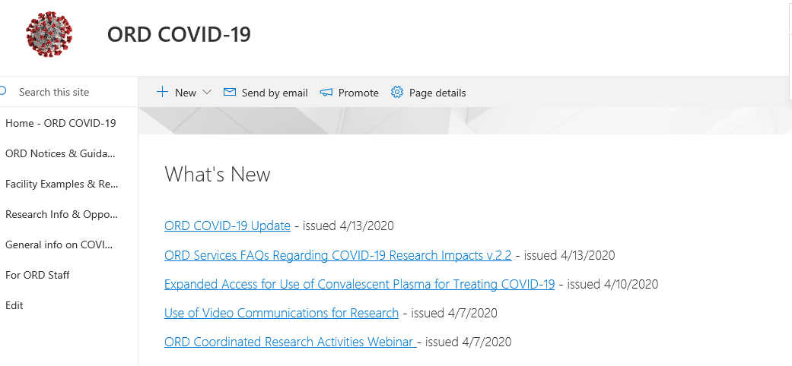
ORD COVID-19 Sharepoint site
https://dvagov.sharepoint.com/sites/vacovhacomm/admin/projects/covid19/SitePages/ORD-Communications.aspx.

Slide 16
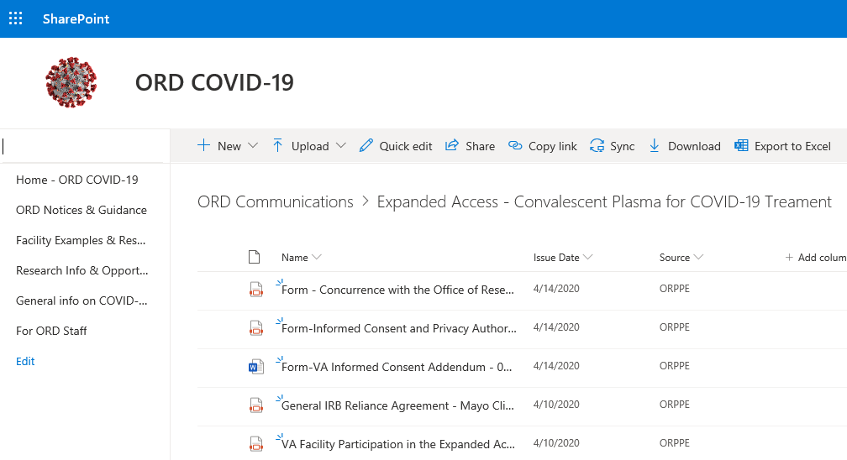
MCD Signs the Concurrence Memo after Reviewing the IRB Reliance Agreement
Shows your facility’s commitment to uphold the agreement the CRADO signed.

Slide 17
After MCD Signature
Keep a copy for your records and send the document to:
  ORO Point of Contact: Priscilla.Craig@va.gov
  ORD Point of Contact: Sarah.Rule@va.gov

Slide 18
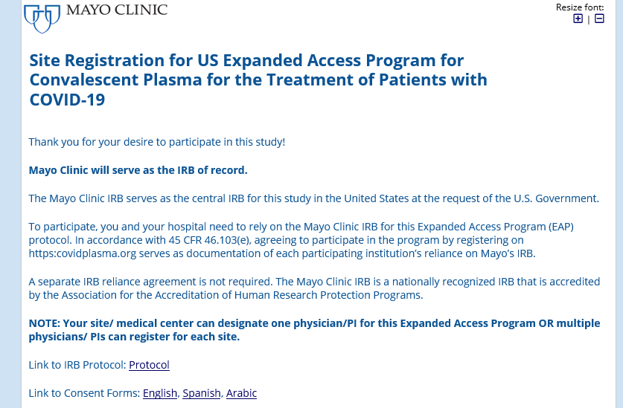
Registration
After submitting your document to ORD and ORO your research office (or someone representing your facility if you don’t have a research office) will register your facility.

Slide 19
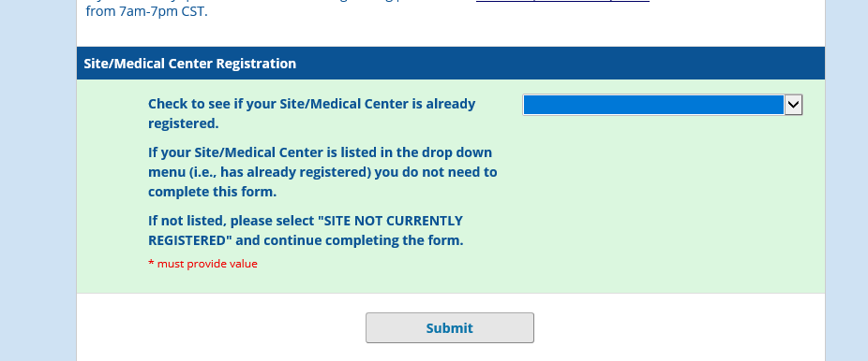
Registration
PLEASE make sure to register with the letters “VA” at the start of the facility name. This will help all of us track which VA facilities are registered.

Slide 20
If You Already Registered
If you registered prior to the announcement of the VHA program involvement on April 10, 2020
  DO NOT RE-REGISTER
  Please let us know what you called your facility if you did not start with “VA”
  Your MCD still is required to sign the Concurrence memo and file it with ORD and ORO

Slide 21
What About Our Federalwide Assurance?
For facilities with an FWA, you do not need to update your FWA
  ORO has granted an exception by using the concurrence memo and sending a copy to them
For facilities without an FWA – you need to complete the VA Special Assurance that ORO created for this expanded access protocol
  CONTACT: COVIDExpandedCoord@va.gov

Slide 22
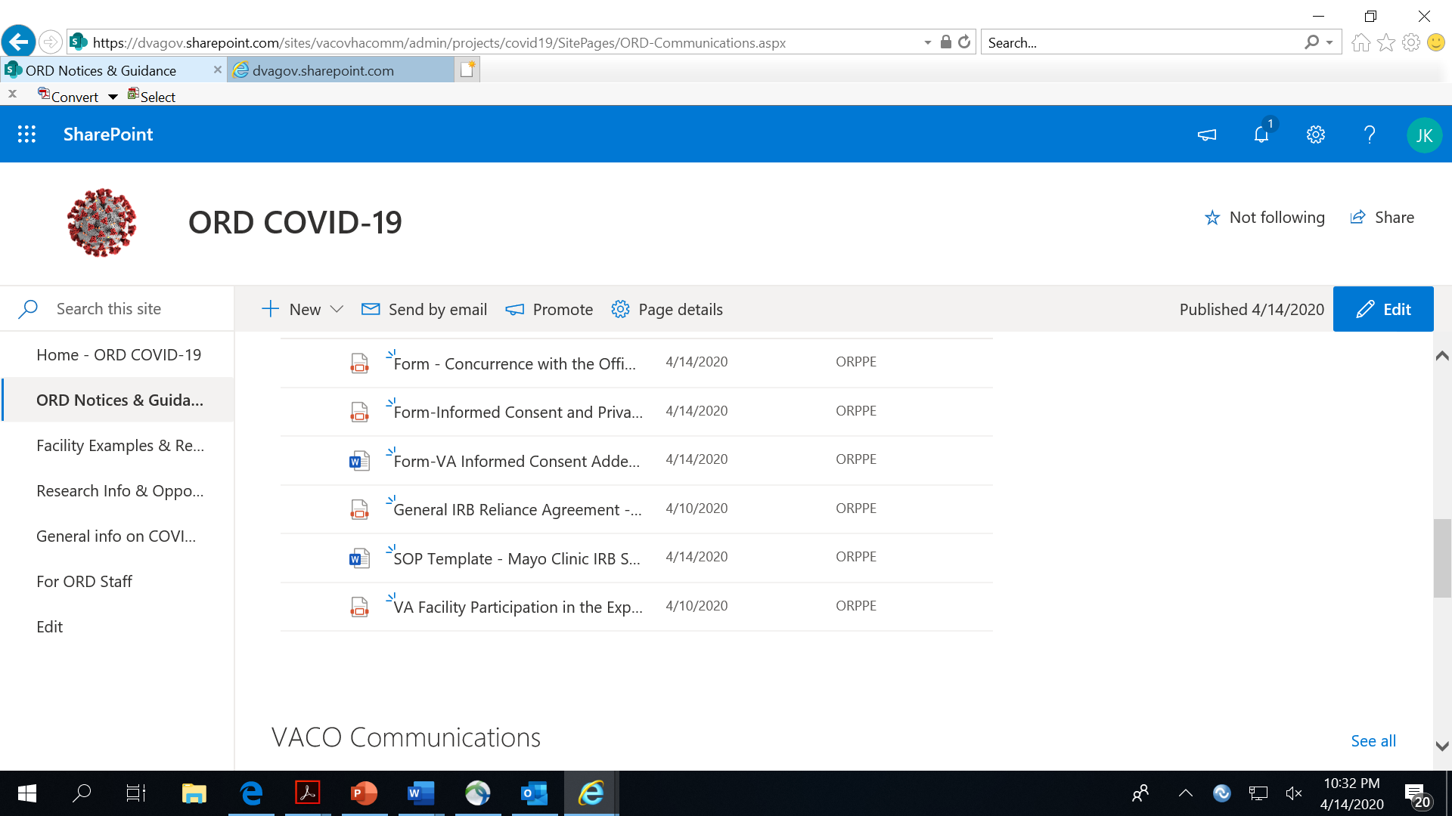
After Registration:
Update Standard Operating Policy for Use of the Mayo Clinic IRB

Slide 23
After Registration:
Update Standard Operating Policy for Use of the Mayo Clinic IRB
Update your Standard Operating Policies using the Mayo Clinic SOP template created by ORO.
  Details the reporting requirements and other essential instructions on relying on the Mayo Clinic IRB
  Mayo Clinic IRB uses an electronic system called the IRB eSystem

Slide 24
R&D Committee Review
Prior to enrolling any patients in the program your R&DC must approve the protocol.
  May be completed through designated review
Facilities without a FWA relying on the Baltimore R&DC will be given instructions on how to obtain R&DC approval
  Contact COVIDExpandedCoord@va.gov

Slide 25
Your Facility Providers
After you have registered you may begin having providers who will likely write the orders for plasma, register as providers for the protocol.

Slide 26
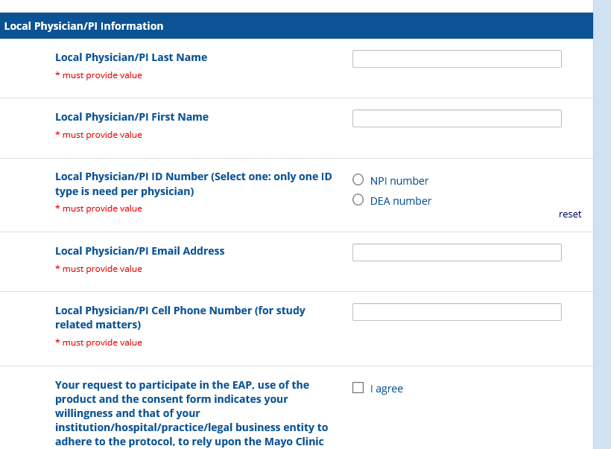
Provider Registration
https://redcap2.mayo.edu/redcap/surveys/?s=N44T8M9PED

Slide 27
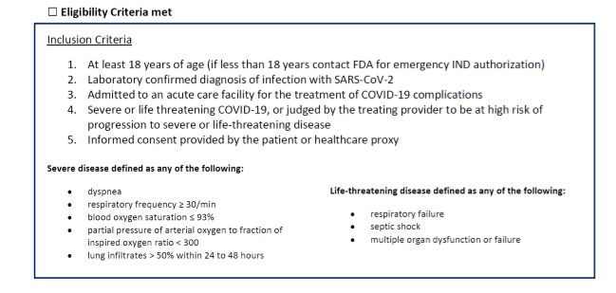
Patient Eligibility

Slide 28
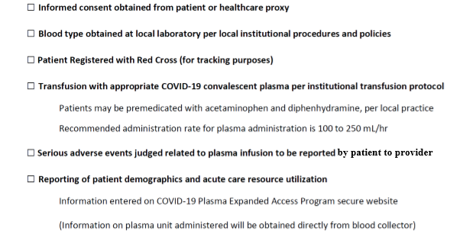
Additional Steps

Slide 29
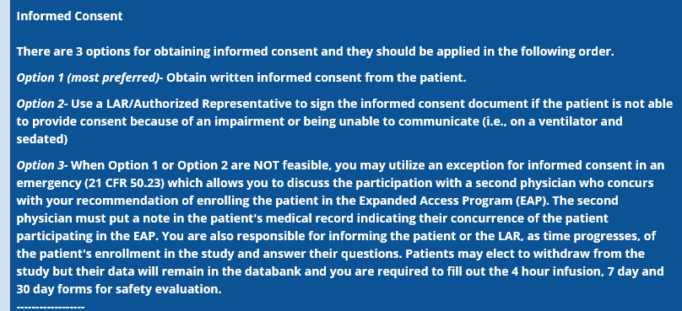
Informed Consent: 3 Options Approved by the Mayo Clinic IRB

Slide 30
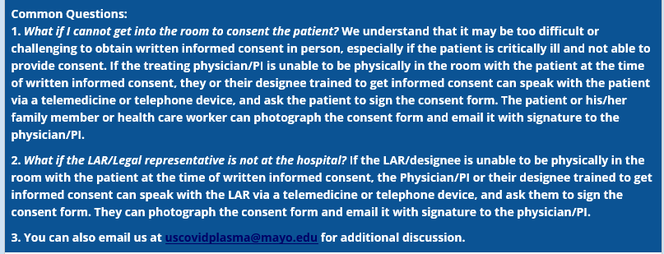
ICF Common Questions
You must consent using the Mayo Clinic IRB Informed Consent/Authorization and VA Informed Consent Addendum Unless Option #3 is used.

Slide 31
Informed Consent
The Informed Consent approved by the Mayo Clinic IRB and VA Informed Consent cannot be altered.
The Mayo Clinic IRB will allow a cover sheet to be added to the consent form to include information unique to the institution’s operations.

Slide 32
Cover Sheet to the Informed Consent
Local site name
Local physician/PI name
Local IRB and/or research advocate phone number and/or additional contact information
Local instructions unique to the center and research operations
Unique identifying information i.e., bar code that allow you to assist the physician/PI in tracking the consent forms and maintaining storage, digitally or in paper.
Additional language which does not alter the risk/benefits section or the main consent language in any material manner.

Slide 33
Blood Type and Transfusion Risks
The provider must find out the blood type of the patient.
  Plasma must be matched
    May limit availability
Standard blood recipient testing
  Consider IgA testing

Slide 34
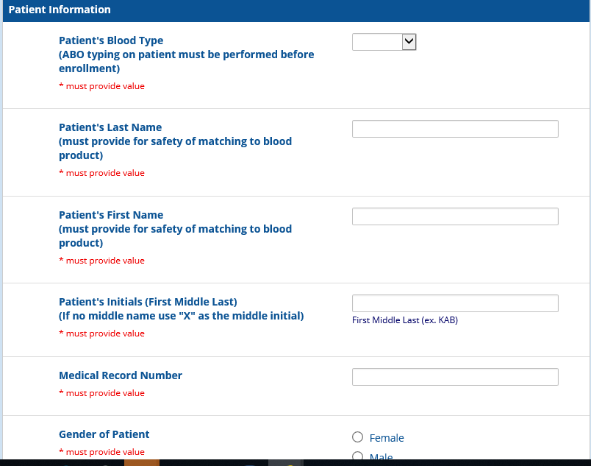
Register the Patient

Slide 35
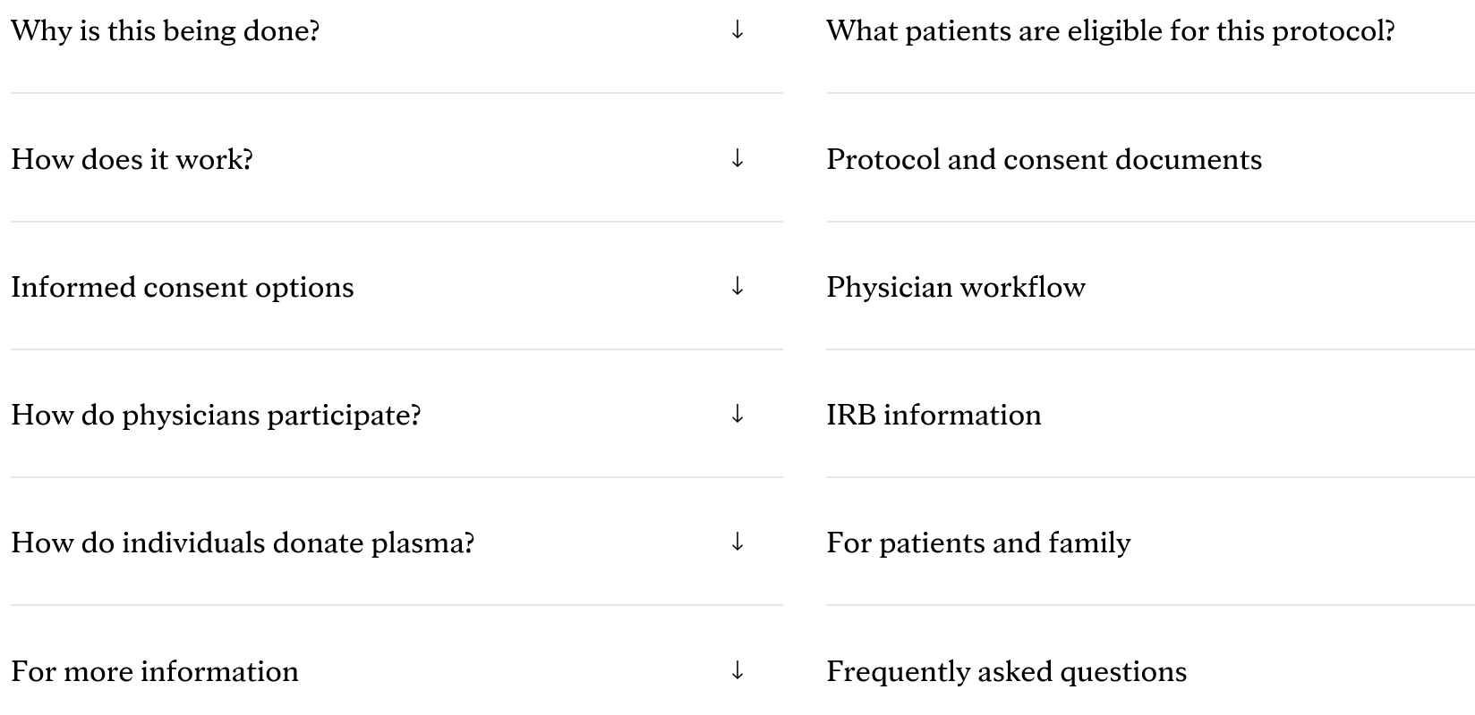
Follow the Physician Workflow
https://www.uscovidplasma.org/

Slide 36
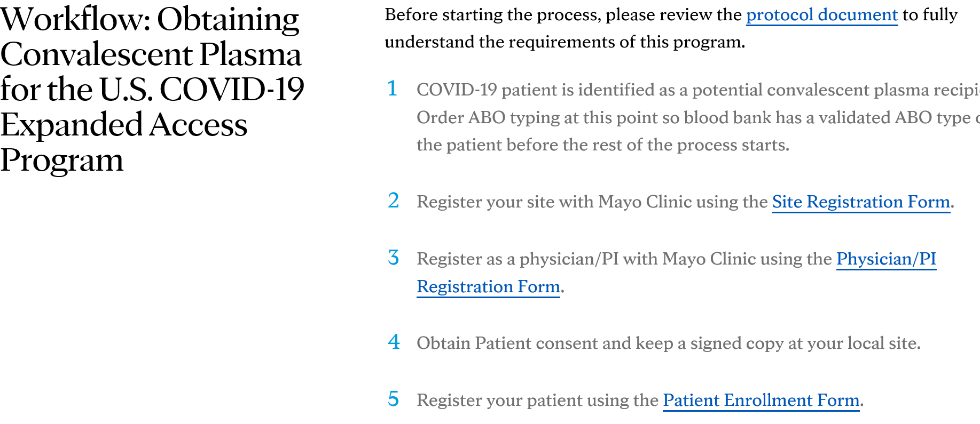
Follow the Physician Workflow:
Physician Workflow
https://www.uscovidplasma.org/

Slide 37
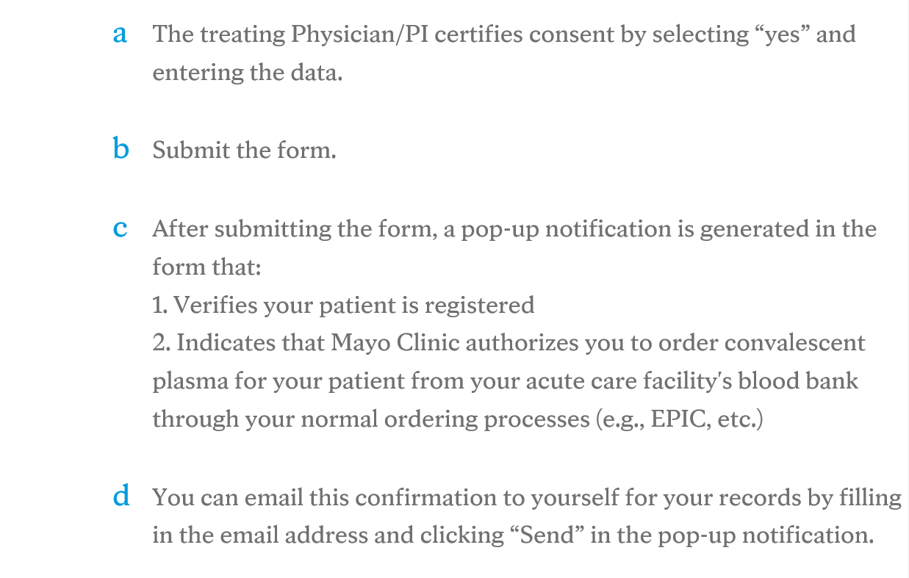
Follow the Physician Workflow:
Physician Workflow (cont.)
https://www.uscovidplasma.org/

Slide 38
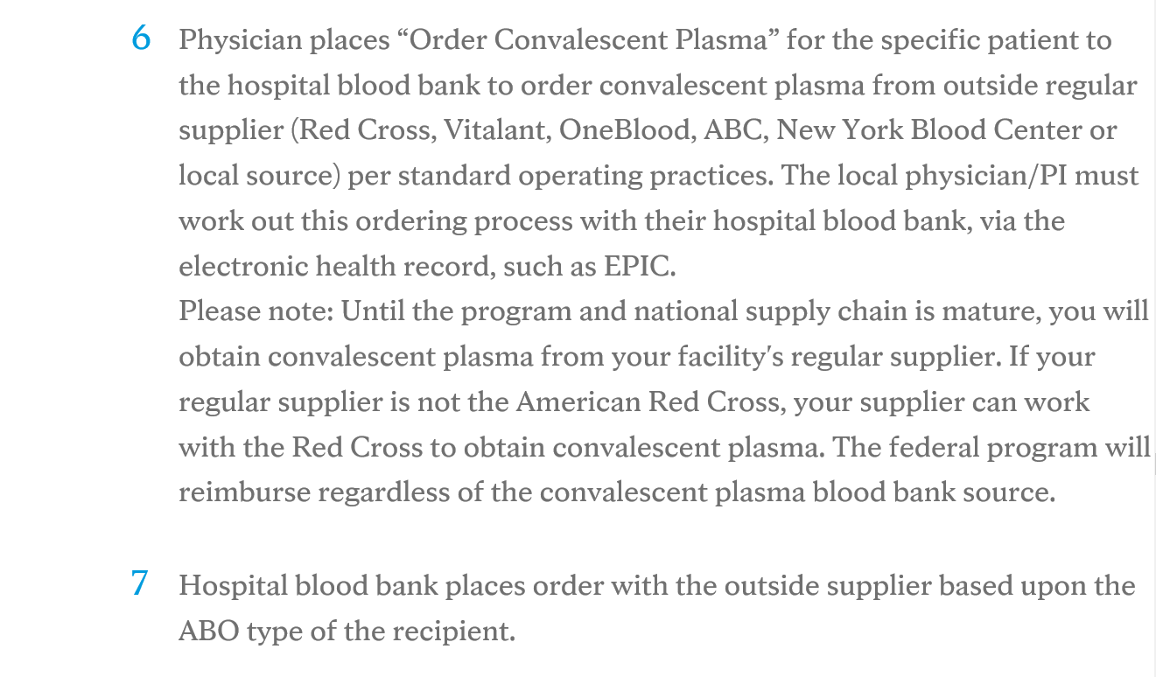
Follow the Physician Workflow:
Physician Workflow (cont.)
https://www.uscovidplasma.org/

Slide 39
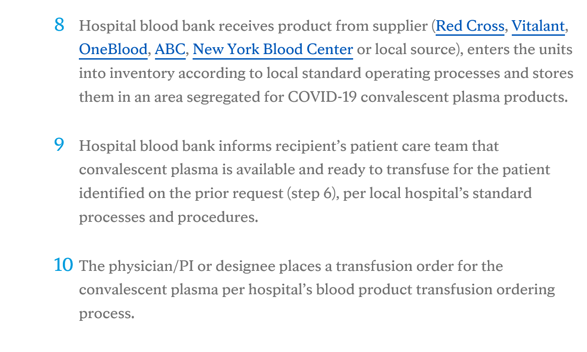
Follow the Physician Workflow:
Physician Workflow (cont.)
https://www.uscovidplasma.org/

Slide 40
Plasma is Delivered
Your blood bank is a key member of this process.
Keep them informed so they can be on the look out for the plasma when it arrives
The blood bank must receive it.

Slide 41
Recheck Inclusion Criteria
Prior to giving the Plasma
  Ensure the patient still meets all criteria for participation in the program
  Consider the possibility of transfusion related events
    Consider pre-medication per local standards
      Tylenol and Benadryl
Giving Plasma
  Infusion rate no higher than 100-250mL/hr

Slide 42
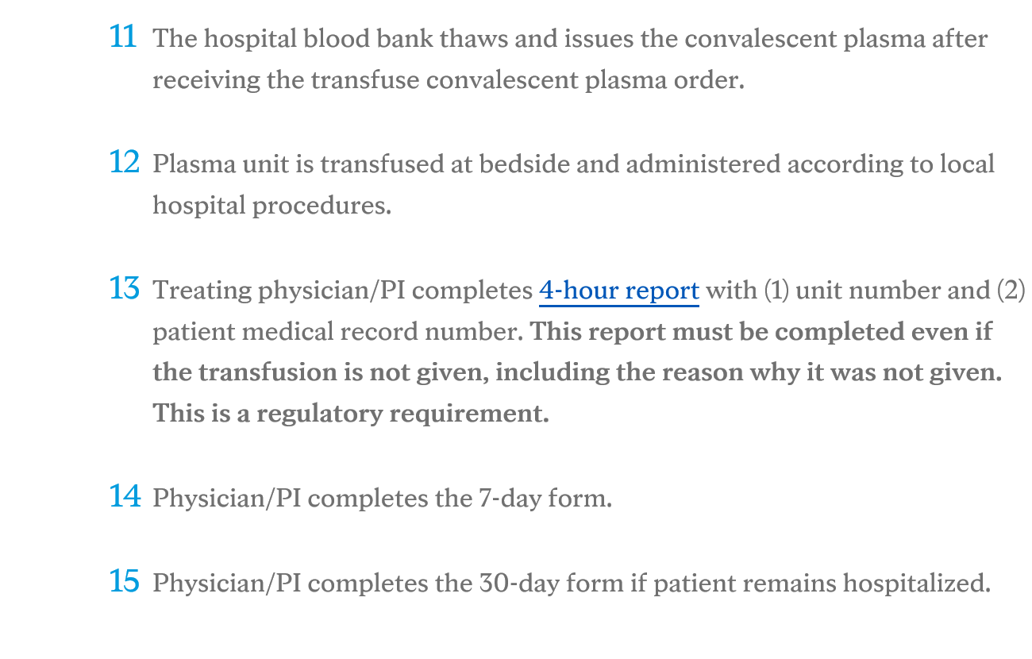
Follow the Physician Workflow:
Physician Workflow (cont.)
https://www.uscovidplasma.org/

Slide 43
Standard of Care
Your facility’s standard of care for treatment of transfusion reactions should be well known to anyone providing the plasma infusion
Review transfusion side effects:
https://www.mayoclinic.org/drugs-supplements/plasma-intravenous-route/side-effects/drg-20060825
https://www.drugs.com/cg/blood-transfusion-reactions.html

Slide 44
Reporting to the Mayo Clinic IRB
Per the information provided in the SOP
There is no role for your local IRB
In addition to the Mayo Clinic IRB you must let your facility R&DC and leadership know of plasma infusion related complications/injuries

Slide 45
Inclusion of Non-Veterans
If someone who is not a Veteran is admitted to our facility under our 4th mission, can he/she be offered this treatment?
  Yes, since this is not a clinical trial but a treatment protocol, the non-Veteran may be enrolled
  The R&DC will need to approve this inclusion of non-Veterans
    The local VA research office will not be responsible for research-related injuries

Slide 46
Plasma Donation from Recovered
COVID-19 Patients
Individuals who tested positive for SARS-CoV-2 and have since tested negative are asked to consider donating plasma through the American Red Cross or your local donation center, which are participating in this protocol.
  When they donate if they will identify with the VA, the VA will get “credit” toward donations for the protocol.
The criteria and timing for donating plasma is determined by local blood suppliers, which may include a second test by your health care provider.
The American Association of Blood Banks (AABB) offers a tool to locate blood donation sites
http://www.aabb.org/tm/donation/Pages/Blood-Bank-Locator.aspx

Slide 47

Questions

Slide 48
Contact Information
Molly Klote, MD, CIP C. Karen Jeans, PhD, CCRN, CIP
Director, ORPP&E Director, Regulatory Affairs
Office of Research and Development ORPP&E
Washington, DC Office of Research and Development
Mary.klote@va.gov Washington, DC
c.karen.jeans@va.gov

Slide 49
Availability of Recording
A recording of this session and the slides will be available on ORPP&E’s Education and Training website approximately one week post-webinar
An archive of all ORPP&E webinars can be found here: https://www.research.va.gov/programs/orppe/education/webinars/archives.cfm

Slide 50
Important Links
ORD Covid-19 SharePoint site (internal to VHA):
https://dvagov.sharepoint.com/sites/vacovhacomm/admin/projects/covid19
Mayo Clinic Convalescent Plasma Expanded Access Website:
https://www.uscovidplasma.org/
American Red Cross: Plasma Donation from Recovered COVID-19 Patients:
https://www.redcrossblood.org/donate-blood/dlp/plasma-donations-from-recovered-covid-19-patients.html

